Slide 1

Pizza ABC restaurant Analysis
FSDA - BERLIN - Group K
Fajar Yanuar Hadi
Firmansyah
Ifan Adi
Hafizhan Lubis
Syihab Agung Satriotomo

Slide 2
CONTEXT & PRESENTATION OUTLINE
1
Current Business Situation
2
Revenue Creation Analysis
3
Cost Reduction Analysis
4
Suggested Approach

Slide 3
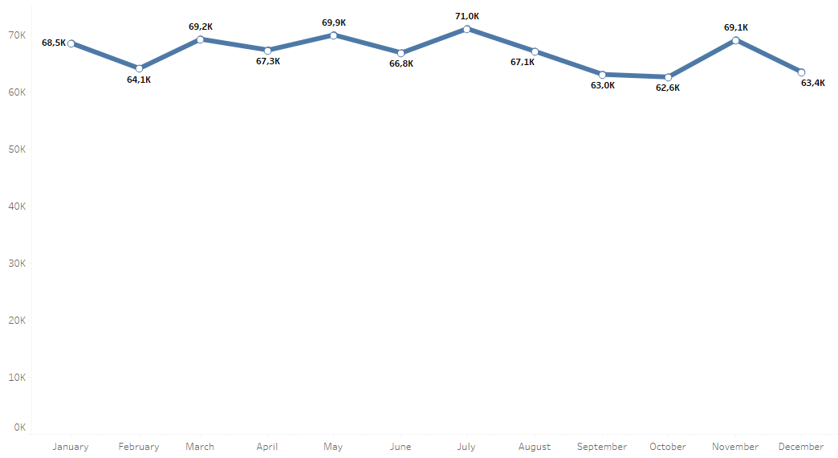

CURRENT BUSINESS SITUATION
Our Revenue by monthly in a year back was Stagnant
In 2015, we gained total $802K from 48K Pizza orders. However if we look from our revenue month by month, the trend is stagnant, range from 63K to 71K (peaked on July 2015)

Slide 4
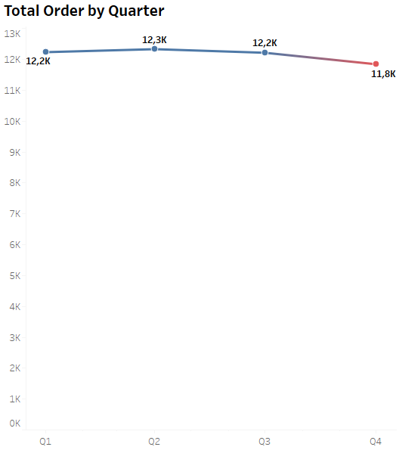
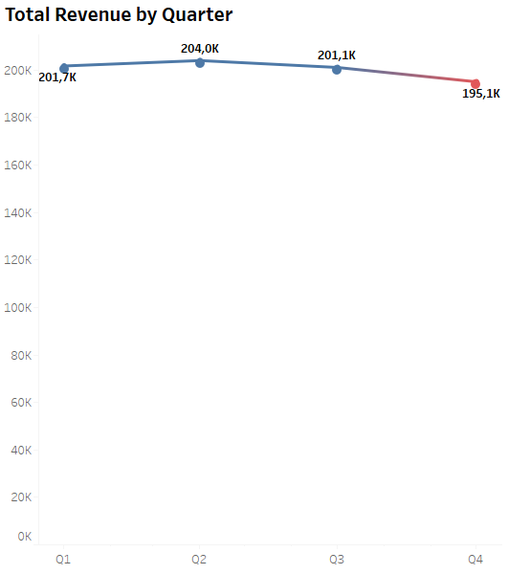
CURRENT BUSINESS SITUATION
Quarterly, number of orders and total revenue decreased
Decreased 3.2%
Decreased 3.3%

Slide 5
PROBLEM STATEMENT
How to increase our number of orders and revenue for the next 1 year?

Slide 6
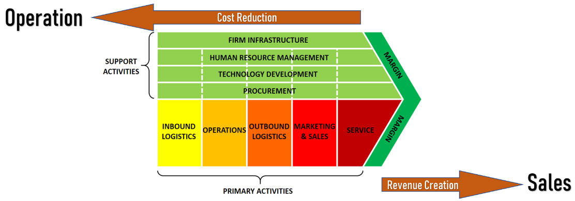
GOAL OF ANALYSIS
Two Strategies in increasing our Business Performance

Slide 7
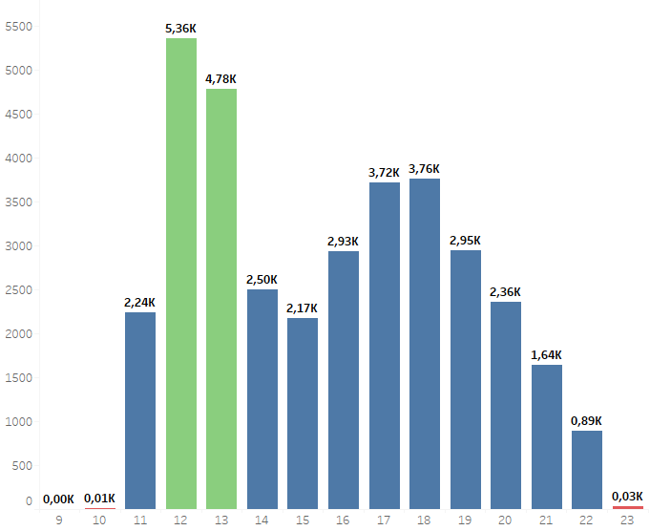
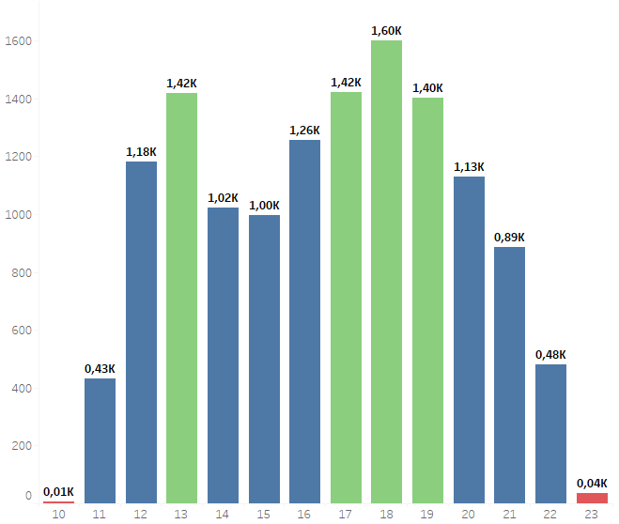
ANALYSIS
Effectiveness Operational Hours

Slide 8
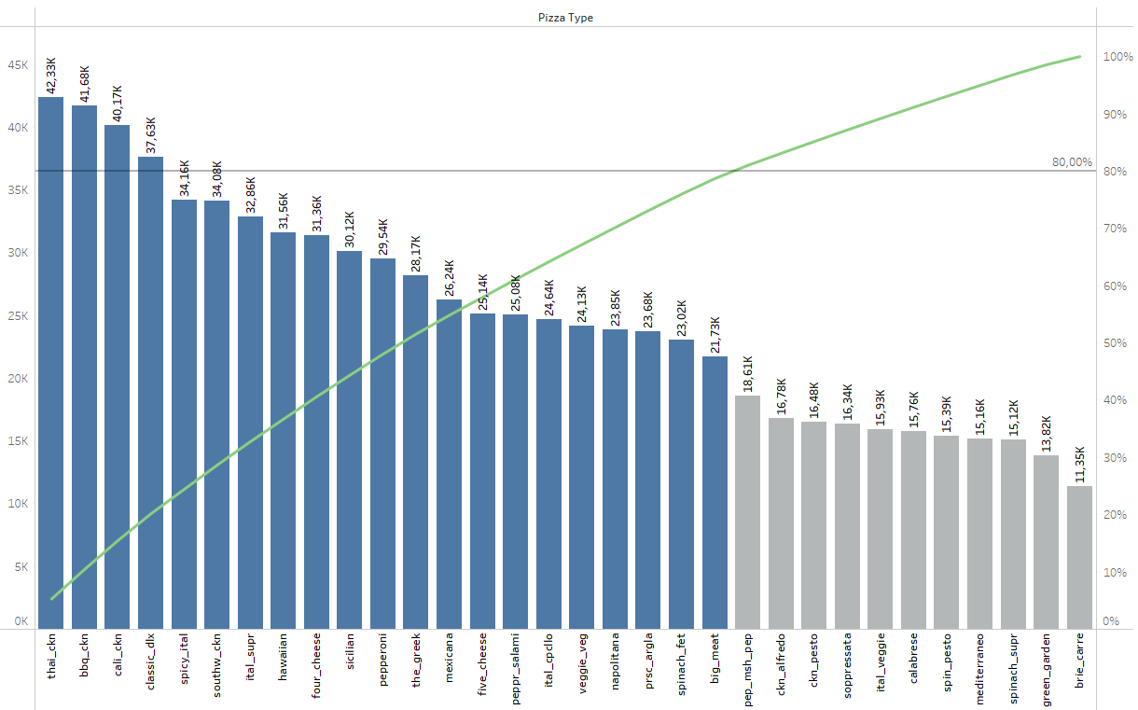
ANALYSIS
Focus on only 80% pareto pizza menu

Slide 9
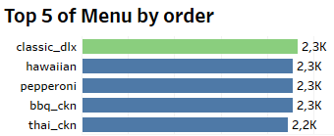
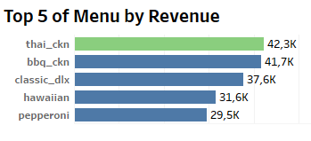
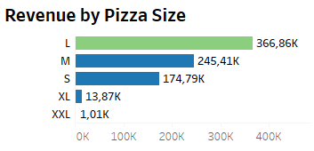
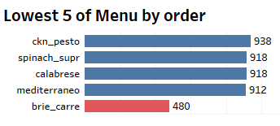
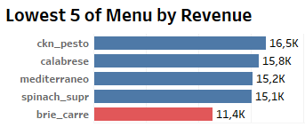
ANALYSIS
Five top and lowest menu by order & Revenue

Slide 10
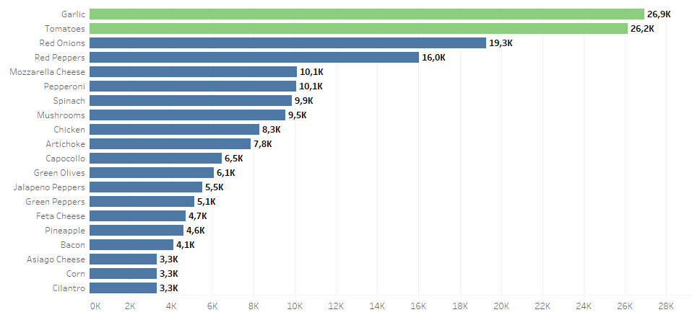
ANALYSIS
Top 20 of Ingredients

Slide 11
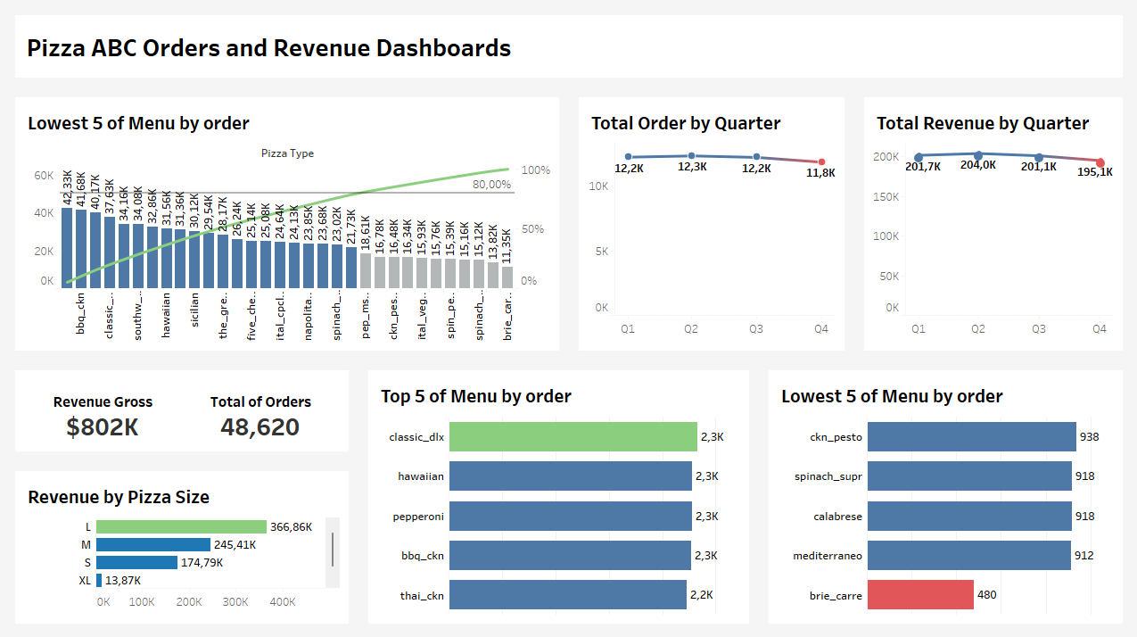

Slide 12
Suggested Approaches
Strategy | Recommendations
Revenue Creation | Research new menu based on favorite pizza ingredients Happy Hour from 2 PM to 5 PM on weekdays Giving Discount on 80% pareto pizza menu & XL size Make a loyalty program ex, offering every 10 pizza free one side dish or every transaction has points that can be traded for one free pizza when reaching certain points
Cutting Cost | Reducing operational hours Eliminate unnecessary pizza size, menu, and Ingredients
Dashboard: Link Here
Google Colab: Link Here

